Slide 1
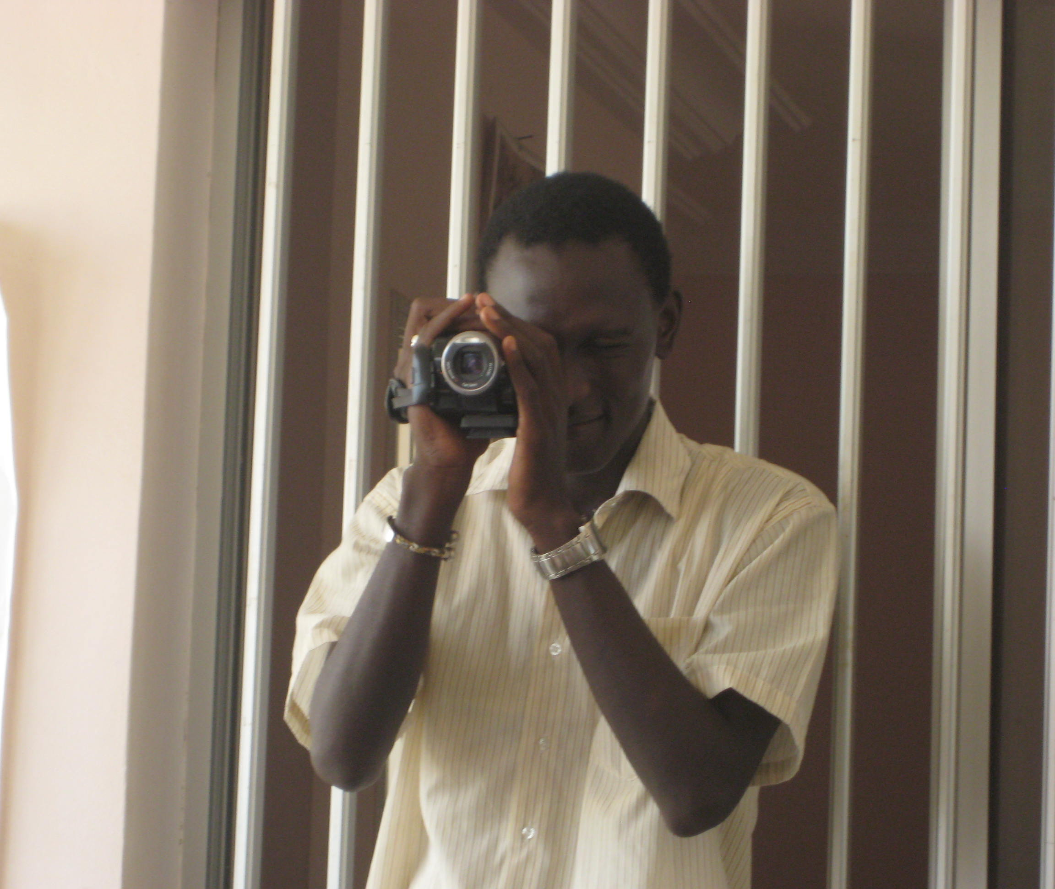
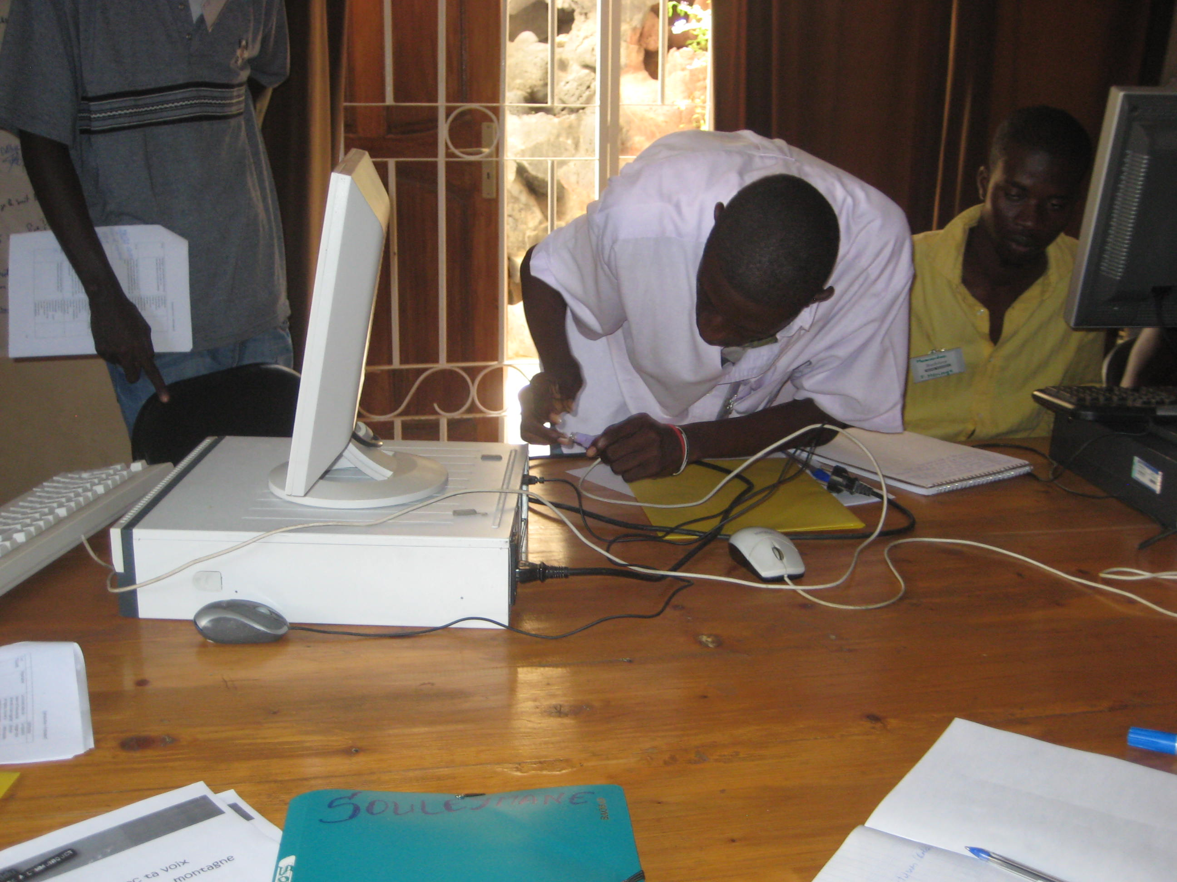
Leveraging New Media Literacies & Social-Emotional Learning to enrich teen education in Senegal NCA Presentation | November 16, 2010
Laurel Felt felt@usc.edu

Slide 2
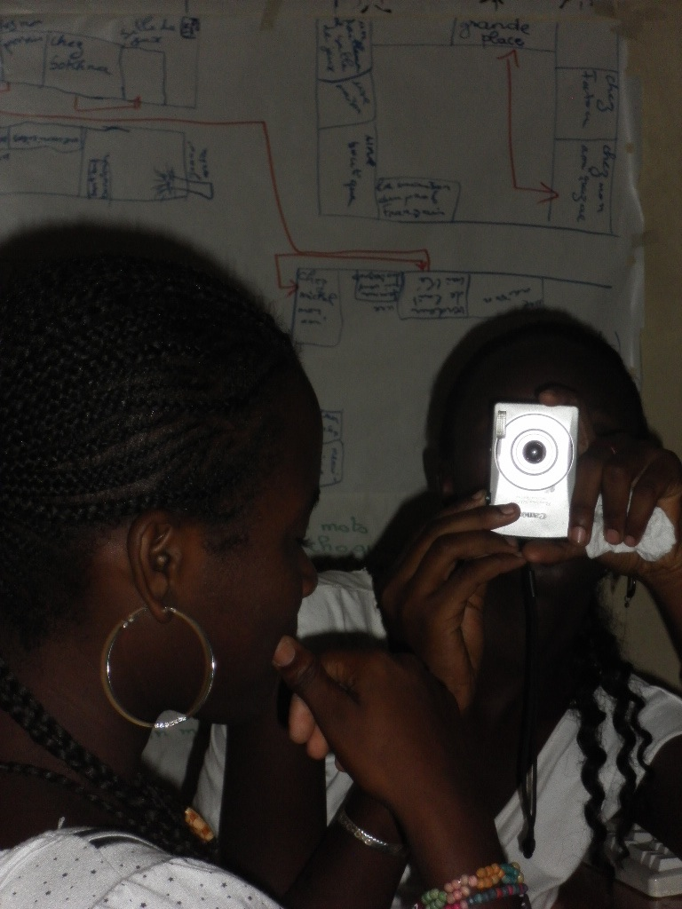
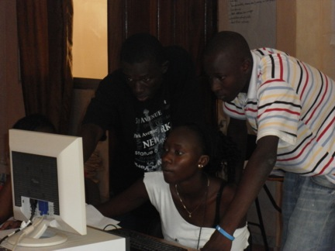
Réseau Africain d’Education pour la Santé (RAES):
Empowering local voices
Notes:
-groundbreaking work prior to this summer's sunukaddu 2.
-Funded over the past two years by the Soros Foundation of West Africa (OSIWA), Sunukaddu had already proven itself an innovative and effective force for social change. Its model was participatory and hands-on, connecting local media experts with motivated teens for training in multimedia message development around HIV/AIDS.
-Participants learned reporting and writing techniques, as well as manipulated digital cameras, camcorders, audio recording equipment, editing software, and web interfaces. Their products are online and educate all who come and click on youths' perspectives vis-à-vis HIV/AIDS.

Slide 3
Sunukaddu 1.0
Multimedia
Training
Campagne Sunukaddu
Notes:
Sunukaddu Campaign that allowed to train dozens of kids and to raise the awareness of nearly half a million youth in the region of Dakar.
I don't think anything like that has ever been achieved : a campaigne designed and run by youth for youth (the last stage of the strategy -- the very reason why we are doing all this = diffusion in order to create a favorable social environment where issues can be discussed, exchanged, debated... and new behavior tried in public) sunukaddu contest (over 400 content received), sunukaddu awards (30 best content selected in a big national ceremony hosted by the first lady of Sénégal), the campagn (stickers, radio & tv shows, posters, songs, sms text messaging, website, animations & concerts in schools...).

Slide 4
Sunukaddu 2.0:
Meaningful Multimedia Communication
Notes:
-RAES wanted to increase the program’s relevance by focusing on communication in general, rather than training in a few technology products about a single issue area
-this past summer, teens in Dakar learned how to communicate effectively via formal instruction in understanding their objectives, audience, and environment, crafting and disseminating messages accordingly, and harnessing multiple techniques, such as journalism and entertainment, as well as modalities, such as conversation, graphic design, print, audio, video, online

Slide 5
New Media Literacies (NMLS)
Play
Performance
Negotiation
Networking
Collective Intelligence
Appropriation
Judgment
Distributed Cognition
Multitasking
Transmedia Navigation
Simulation
Visualization
“…a set of cultural competencies and social skills that young people need in the new media landscape”
-Jenkins et al., 2006, p. 4
Notes:
--Let’s begin at the beginning. Just what ARE the “new media literacies”?
-in 2006, Henry Jenkins and a group of collaborators published a white paper for the MacArthur Foundation entitled “Confronting the Challenges of Participatory Culture: Media Education for the 21st Century”
-they defined NMLs as “…a set of cultural competencies and social skills that young people need in the new media landscape”; this is an important definition. Despite the words “new” and “media” in their label, NMLs are neither new nor exclusively for or about media. They’re especially useful in the context of new media, but they’re fundamental, time-honored skills and they are not about technology.
-They're about enriching learners with useful, versatile capacities that help them think sharper, work better, and appreciate fuller the ethical ramifications of their actions.

Slide 6
NMLs Explained
Notes:
-This short explanatory video does a good job of explaining

Slide 7
Social and Emotional Learning (SEL)
Recognize and manage their emotions
Set and achieve positive goals
Demonstrate caring and concern for others
Establish and maintain positive relationships
Make responsible decisions
Handle interpersonal situations effectively friendships and resolve conﬂicts respectfully
Notes:
-- form the individual, set the stage for living with yourself and others -definition: “… the process through which children and adults acquire the knowledge, attitudes, and skills to:

Slide 8
SEL Core Competencies
Self-
awareness
Self-management
Social awareness
Relationship skills
Responsible decision-making
Notes:
-Empirical research has found that recipients of SEL training tend to utilize more daily behaviors related to getting along with and cooperating with others, and report “more positive attitudes toward self and others (e.g., self-concept, self-esteem, prosocial attitudes toward aggression, and liking and feeling connected to school)” than peers in a control group. SEL programming has also been linked to an average gain on achievement test scores of 11 to 17 percentile points (Payton, Weissberg, Durlak, Dymnicki, Taylor, Schellinger, & Pachan, 2008, pp. 6-7).
-Moreover, SEL programs provide an impressive return on investment in terms of dollars and cents and sustained behavior change (Botvin, 1998, 2002; Hawkins, Kosterman, Catalano, Hill & Abbott, 2008; Schaps, Battistich, & Solomon, 2004).
-This sense of intrapersonal integration and social connectedness prepares individuals for meaningful learning (Durlak & Weissberg, 2007; Goleman, 1996, 2006; Hoffman, 2000; Zins & Elias, 2006) by freeing them from preoccupations and enabling richer engagement.
-It also supports their sense of safety and self-confidence, which enables exploration and risk-taking

Slide 9
Theory + Practice

Slide 10
Model

Slide 11
Asset Appreciation
Notes:
Asset appreciation aims to capture the extent to which an actor recognizes the availability of internal and external resources and exploits them to their fullest potential.
recognize what you’ve got – intrapersonal AND interpersonal -- and optimize
consider every level: nano, micro, meso, macro which means intrapersonal, intimate circle, local community, broader society

Slide 12
Narrative
Notes:
The power of narrative…
-- stories as robust educational tool (entertainment-education)
AND
-- _the stories we tell ourselves_
-- Theory of possible selves contends that people are motivated by visions of the person they could become if they make good choices, and the person they could become if they don’t make good choices
-- if you only tell yourself that you’re going to be the best, then you become cocky and flabbergasted, lost when the road gets bumpy
-- if you only tell yourself that you’ll amount to nothing, then you become defeated and unable to seize opportunities that might present themselves
-- so the stories we tell ourselves about who are and who we could be, to a certain extent, circumscribe our trajectories
(-- stories are also essential to humanity and are the means by which we assimilate information – we tell a story about it; that’s how we understand, that’s how we remember)

Slide 13
Impacts: From the Inside Out
“To discover my skills and my potential”
“The courage to express myself and overcome my shyness, complexes, and my fears”
“Self-management, especially in moments of anger”
“Developing patience, concentration, motivation”
Notes:
Self-awareness
- To discover my skills and my potential
The courage to express myself and overcome my shyness, complexes, and my fears
Self-management
- Self-management, especially in moments of anger
- Developing patience, concentration, motivation

Slide 14
Impacts: From the Inside Out
“Increased sociability”
“Better understanding of others -- in general, conceptualizing what makes them tick, as well as a better ability to read people in the moment”
“New insights and tools for managing relationships, both personal and professional”
“Exercising judgment, valuing personal growth, maturity, and responsibility”
“Learning how to make choices and consider career paths”
Notes:
Social awareness
- Increased sociability
Better understanding of others -- in general, conceptualizing what makes them tick, as well as better ability to read people in the moment
NOTE: With these capacities, participants commented that they can develop and share messages more effectively
Relationship skills
New insights and tools for managing relationships, both personal and professional
Responsible decision-making
- Exercising judgment, valuing personal growth, maturity, and responsibility
Learning how to make choices and considering career paths

Slide 15
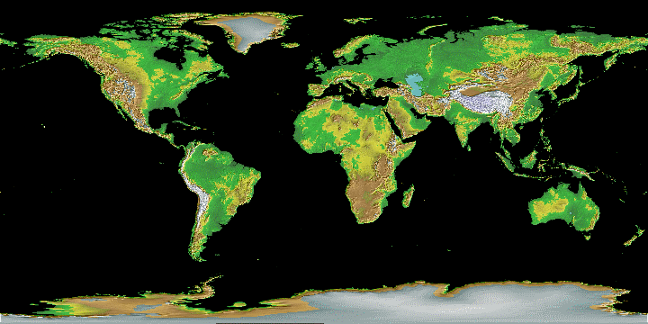
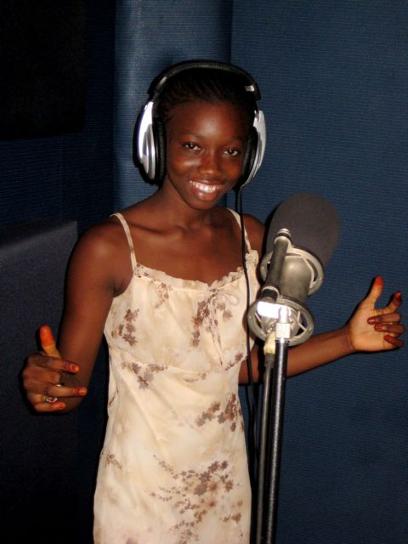
Community
Notes:
-writ large, what all of this implies is community – helping youths to regard their minds, their bodies, their schools, their neighborhoods, their world as rich, promising places to live – places with potential

Slide 16
Onward!
-
Notes:
these strategies will fail if they are not implemented by locals. The whole reason we work with local actors is because they are legitimate. Thus their communication activities have a real impact (compare to SOcial Marketing interventions). The novelty is the bottom-up approach. Seems so trivial in the US but we are still fighting like cougars in the Global South to persuade funders it is the way to go. Why ? Because again, if communication comes from communities then it discuss thematics/issues in a cultural appropriate way but also it pictures real issues and problems and not the one we are assuming. All the assessment in the world, formative research, and anthropologic studies won't reveal the hidden social rules that most of the time impeach new behavior and attitude, and most programs miss the point and fail. So let's train locals, (and in the case of sunukaddu, our "targets") to identify which are these hidden rules, and discuss them on their own term.

Slide 17
Acknowledgements
Alexandre RIDEAU
Idrissa MBAYE
Tidiane THIANG
Charles SOW
Amadou DIA
Mbathio DIAW
Tout l’equipe de RAES
Les participants de Sunukaddu
Brock DUMVILLE
Dr. Michael CODY
USC Annenberg
Dr. Henry JENKINS et NML
Dr. John PAYTON et CASEL

