Slide 1
A Face is Worth a Thousand Words: Investigating Volunteer Teachers’ Non-verbal Sensitivity in the Classroom Laurel J. Felt USC Annenberg School for Communication and Journalism Jodie Guller USC Dornsife College of Letters, Arts, and Sciences Ashley Harlow USC Dornsife College of Letters, Arts, and Sciences Shivika Poonglia USC Marshall School of Business

Slide 2
JOINT EDUCATIONAL PROJECT (JEP)
Notes:
The Joint Educational Project at the University of Southern California was founded in 1972 to link academic learning with experience in our urban community.
JEP prides itself on fostering the intellectual, social, and ethical development of USC students while offering highly valued services to community residents.
2000 TIME/The Princeton Review College Guide: “USC’s may be the most ambitious social-outreach program of any private university in the nation” (Hornblower, 2000, p. 71) --- contributing factor in declaring USC as the #1 university that year
1000 undergrads sign up per semester, usually retain about 75% →approximately 1500 students per year serve the community through JEP
-Multiple volunteer assignments facilitated by JEP among dozens of sites:
--hospitals and clinics = Trojan Health Volunteers (clerical and lab aides), Community Outreach Through Development of the Arts (performers and art therapists)
--non-profit organizations, e.g., 826LA, CARECEN = Youth and Family Agencies (program assistants and mentors on varied projects, like creative writing and studying for citizenship exam),
--shelters, e.g., A Place Called Home = Supporting Foster Youth in Transition to Adulthood (mentors)
--SCHOOLS =
JEP Complementary Programs:
-ReadersPlus (reading books aides)
-Math Mentors (math mentors),
-Young Scientists (science instructors),
-Literacy Program (writing mentors),
-Voluntary, self-organized after-school programs: WonderKids, Little Yoginis
JEP Regular Assignments:
-Teaching Assistants (help teacher with management of class)
-Mentors (assigned by teacher to work with specific kid or kids over semester)
*Special mentorship assignment: Project Read
-Mini-teams (grouped by PA with 1-5 classmates and tasked to teach weekly, 45-minute lessons to class of students, K-12)
*Special mini-team assignments – -pre-established curriculum/mission: Art Smart, IR Explore, Financial Literacy, Media Literacy, Art of Living

Slide 3
MINI-TEAM PROGRAM
JEP logistics training (e.g., attendance)
Mini-teams observe host classrooms
First lesson planning + run-thru of first lesson
Reflective essays
Weekly planning by mini-team, approval by PA
Observations by PA & host teacher
Second training
Blackboard discussion
Evaluating Student Learning
Performance evaluations by PA & host teacher
Notes:
Red = new S2013
Lesson planning -- Weekly lesson plan review: coordinate with mini-team peers (some experienced), get approval from PA
Second training = group discussion; bak = Effective (and Not-So-Effective) Lesson Plans; F2012 = What do students learn from mini-teams besides content?
Blackboard Discussion = online group discussion: F2012 = Service-learning requirement for GE courses? S2013 = Helpful resources for classroom management
Evaluations by participating teacher and PA

Slide 4
PROBLEM
Never Teach
How
to Teach
Notes:
-e.g., strategies for behavior management, how to keep students’ interest through facial expressions/gestures/pitch/intonation/walking around the room, teaching best practices, developmental appropriateness, etc
-JEP mini-team members keep coming back, local students enjoy JEP mini-team members’ visits, and host teachers invite them back
-BUT! Drawing from:
JEP mini-team members’ reflective essays*
Observations from Program Assistants and host teachers
Laurel’s observations
* I felt that our lecture last Thursday was actually too long; some kids were losing focus. –Tiffany, 10/13/12 Unfortunately when we started our earthquakes discussion, students tuned out because they did not get the answers they wanted quickly. –Justin, 10/28/12
…We [mini-team instructors] quickly came to realize that the students talk amongst themselves when given the opportunity. If the students are not being productive it is easy to tell, so we need to stop it immediately and let them know that it is not okay for them to talk. Another indicator that students are not listening is that they zone out and stare off into space. This has been more difficult to deal with because they are technically not being disruptive. My goal in the second half of the course is to help stop this from happening and to find a way to engage these students who do not appear as interested in the material. –Catherine, 10/28/12

Slide 5
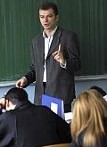
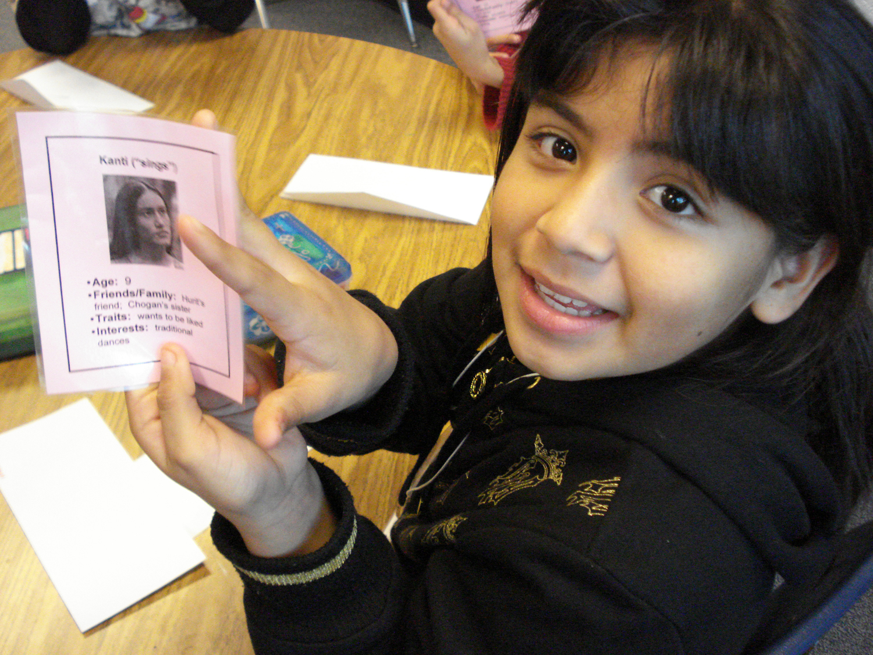
IMPLICATIONS
More Talking TO
Less Talking WITH
More Tuning OUT
Less Tuning IN
Notes:
-Often, JEP mini-team members are not completely present – they fail to notice their students’ non-verbal communication and/or respond to these expressions.
The mini-team members fail to engage in give and take, do not creatively explore imaginary possibilities with their students, do go “off book” – they execute the lesson plans they constructed with their teammates and got approved by their PA.
-Local students are not determining curricular foci – they have limited control over the work that they do in their class. The probability that their passions and interests and lived experiences are the subject of study is slim. As such, it is unlikely that space for students to meaningfully connect with their studies will open up. These occurrences are called “teachable moments” (Havighurst, 1952; Pacifici & Garrison, 2004). Due to mini-team members’ teaching style, it is also unlikely that in the event of this space opening, the mini-team members will honor or leverage it, following the students’ lead and exploring the students’ passions.
This is problematic because students better recall lessons that engage their emotions (Immordino-Yang & Damasio, 2007; Meyer & Turner, 2006) and strike them as relevant (Lave, 1996), and these learning experiences prove more transformative and than didactic lessons. Experientially, students and teachers tend to prefer these rich, rewarding experiences over struggles for attention and control.

Slide 6
INTERVENTION
Online curriculum facilitating:
Sensitivity to non-verbal communication
Comfort with improvisation
Knowledge of best practices
Strategies for effective intra-group communication
Notes:
1 and 2 = theoretically inspired, equipping mini-team members to be equipped for requirements of “completely present” and “creatively exploring imaginary possibilities together” (Pacifici & Garrison, 2004, p. 126)
3 = inspired by Laurel’s stint as a PA and first round of observations (6 observations during the week of 3/5-3/12). Realized that many of these mini-team members just need to know about basics, like creating visual aids, presenting with animation, learning kids’ names and calling on them by name, etc
4 = inspired by observation two days ago, on Tuesday, 4/9, when Ashley and Laurel observed a mini-team in which one mini-team member was a strong teacher but possibly inconsiderate fellow group member.

Slide 7
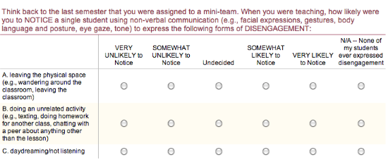
FORMATIVE RESEARCH
Notes:
-surveyed JEP participants at beginning of F2012 regarding their ideas about whether being able to play is an ability and whether it can be taught
-surveyed JEP participants’ at beginning and end of F2012 regarding their evaluation of their own playfulness and comfort with making up as they go along, learning on their feet, etc
-surveyed JEP participants at beginning of S2013 regarding their awareness of and responses to non-verbal expressions of disengagement, low-moderate engagement, and high engagement
-will observe JEP mini-team members whose responses to S2013 pre-survey indicated that they were likely to notice, likely to respond, and interpreted such expressions thoughtfully
-5 observations during the week of 4/8
-Laurel and a Research Assistant go on each observation, one facing the students and noting their non-verbal (and verbal) expressions, the other facing the mini-team members and noting the mini-team member of interest’s style, as well as how she/how interacts with fellow mini-team members
Research Assistants will interview this individual and learn more about what went on early in the semester and continues to occur behind the scenes – are group members introverts or social loafers? Is this strong teacher loath to relinquish power, or other team members loath to call him on his domination? How can warning signs be heeded and respectful, productive conversations facilitated?

Slide 8
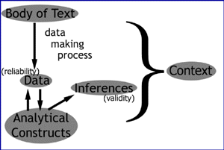
ANALYZE
Notes:
-observations
-qualitative and quantitative contributions from S2013 pre-survey (and notions of play from F2012 survey)
-Bb discussions (in which approximately 400 JEP mini-team members participated, 3/11-3/15):
SUGGEST three (3) ideas that will help future mini-team members to address the issue of how to teach. This idea might be a tip, a strategy, a best practice, an activity (such as an icebreaker or wrap-up), etc. Consider whatever you believe will help to support students' comfort, relationships, comprehension, growth, recall, etc. Each suggestion must: A. Provide context -- how are mini-teams currently challenged? Tell about a specific struggle that they negotiate. B. Explain how this idea will meet the challenge that you detailed. How does it ease or eliminate a struggle that mini-teams currently negotiate? After reviewing your peers’ suggestions, VOTE on (minimum 2, maximum 4) the best ideas. Each vote must: A. Identify the idea and its author. B. Justify why this suggestion is among the most important suggestions for enriching future mini-teams’ instruction.
*Note: At least one (1) of your nominations must be an idea submitted by someone else. In other words, you cannot solely nominate your own ideas.

Slide 9
DESIGN
Notes:
-multimedia curriculum that addresses the areas of knowledge/skill we found/will find most vital: sensitivity to non-verbal communication, comfort with improvisation, knowledge of best practices, strategies for intra-group communication
-incorporating badging component as method for articulating goals, building community, promoting achievements, stoking motivation, expressing JEP’s values
-will use BadgeStack’s plugin or credly or p2pu.edu’s platforms – still evaluating

Slide 10
PILOT
FALL 2013
Notes:
Gather data
Pre- and post-survey
In-system data scraping
PAR Observations, Interviews
Bb discussion
Dyad interviews with community students regarding their experiences?

Slide 11
POTENTIAL CONTRIBUTIONS
Pedagogy and practice
Non-verbal communication
Group communication
Service-learning
Pre-service teacher training
Social and emotional learning
Participatory Action Research
Digital Media & Learning

Slide 12
ACKNOWLEDGEMENTS
USC Dornsife
USC Annenberg
Henry Jenkins
Lynn Miller
Virginia Kuhn
Brendesha Tynes
Susan Harris
Jake Peters
Tammy Anderson
Christina Kozeany
Brenda Pesante
Emma Rendon
Jacqueline Whitely
Alexander Fairman
Sable Manson
Yujung Nam
Program Assistants
Host schools, teachers
Vicki Callahan
IML 420

Slide 13
Laurel Felt
felt@usc.edu
www.laurelfelt.org
Thank you!

