Slide 1
Cultural Beacons
Grassroots Indicators of Change
Lucia Dura, Laurel J. Felt, Arvind Singhal
ICA 2013
Notes:
Speed networking? Why are you here today?
And share out with us so we can orient our presentation accordingly—and this can be incorporated to your discussion about opening spaces for the unexpected, shared visions, etc. In case the 1-2-4 at the end does not pan out quite as well as we thought.

Slide 2
Notes:
2009, group empowerment intervention
-As the assessment team walked for several kilomenters in the Ugandan bush to see the girls’ magnificent gardens lush with g-nuts (peanuts), sim sim, sunflowers, and more. Two members of the research team pointed out that, along the road, there were whole g-nuts on the ground. Jimmy, a member of the local Save the Children staff, offered a simple explanation:
G-nuts on the ground are a sign of abundance. Before, people were so hungry that if there ever was a g-nut on the ground, it would be eaten immediately. Now you also see birds in the campsites. They eat food scraps and, before, they didn’t use to come.

Slide 3
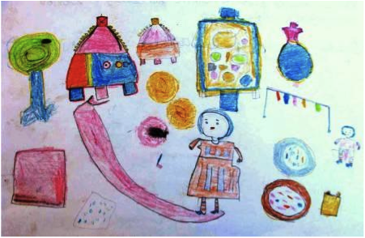
Cultural Beacons in Theory
Trained incapacities
Tacit knowledge
Participatory, locally-relevant methods
Grassroots epistemologies
Notes:
the loss of ability to think beyond one’s training (p. 7).
-therefore, scholars and practitioners design instruments that only seek data on particular contexts, only seek particular kind of data – favors the textocentric, often quantitative
-issue of expression: literacy (reading and writing); influence of non-native or highly educated backgrounds on word choice; cultural norms around speaking of certain subjects at all (taboo + feelings), trust, power; time and place
-Albert Einstein’s self-coined mantra was: “We can't solve problems by using the same kind of thinking we used when we created them.”
traditional data-gathering does not wholly capture program-related transformations (Smith, 1999; Shiva, 2005; Dutta & Pal, 2010);
non-traditional, non-textual, and participatory forms of knowledge-generation can yield overlooked data; and
local wisdoms, enshrined in grassroots epistemologies, can enrich program design and evaluation.

Slide 4
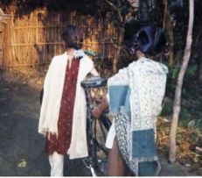
Notes:
2002 to 2003, Taru was a media and community-based intervention to create healthy communities in rural India. Taru’s purpose was to promote gender equality, reproductive health, caste and communal harmony, and community development. Taru, enjoyed a platonic relationship with a male classmate, Shashikant.
PROMPT: photograph and narrate visible signs of change in their communities after active program viewing.
Seventeen-year-old Vandana’s sartorial choice may reflect her independence – perhaps even her defiance – of traditional norms. For her companion, Vandana explained: "This is my boy-friend, a boy who is a friend. He studies in my high school…I feel comfortable talking to him and sharing my thoughts with him. If Taru and Shashikant [a male character] can be good friends, why can’t we?" Such reasoning and behavior is revolutionary as, according to community members, this is perhaps the first time in the history of Kamtaul village that a young woman invited a young man to stand beside her and pose for a photograph.
“These girls are trying to learn to ride a bike. After listening to Taru, girls are changing. By listening to radio these girls learn of new ideas and act on them” – Mukesh (22)
Whether Mukesh independently derived this interpretation or obtained confirmation from the girls is unclear. Thus, his observation toes a potentially problematic line in terms of speaking on behalf of others, particularly those who are lower in status due to ethnicity, gender and/or age. Cultural scorecards, because they consist of participants’ own accounts, help researchers to avoid this very practice vis-a-vis participants. But in the case of this cultural scorecard, it is a community member himself who might be imputing meaning to the participants’ story. Researchers can raise participants’ awareness to this phenomenon and encourage them, as they themselves are modeling, both to respect individuals’ right to make sense of their own experiences and to seek this input from the people directly involved. Researchers can also appreciate accounts such as Mukesh’s as secondary data, thereby recognizing its potential difference from the primary source’s as well as its richness as an additional layer of meaning-making.

Slide 5
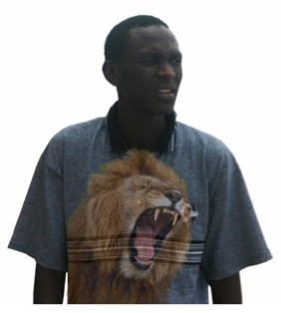
Cultural Beacons in Action
Incorporate Participatory Practices.
Embrace “Unusual Suspects.”
Nurture Relationships.
Share Vision(s) and Ownership.
Open Space for the Unexpected.
Notes:
Whose experiences do these data reflect, and whose voices are absent? What data is collected, and what is not? What data characteristics lend credibility to local wisdom, and what characteristics prompt its dismissal?
PMs:
Artistic, musical, oral, and visual performances
Participatory visualization techniques (e.g., participatory photography and sketching) accompanied by oral narratives
The Most Significant Change (MSC)
participatory appraisal and asset mapping.
Scrutinize likely CB sites: material possessions, natural resources, social behaviors

Slide 6
Strengths Challenges Implications Questions
Notes:
Turn to somebody next to you and discuss what you see as the strengths, challenges, implications, and questions you may have.

Slide 7
Thank You
Lucia Dura ldura@utep.edu
Laurel Felt felt@usc.edu
Arvind Singhal asinghal@utep.edu

