Slide 1

Lasswell
Who
Says What
In Which Channel
To Whom
With What Effect
Notes:
Harold Lasswell, definition of communication

Slide 2
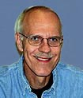
“The process by which a complex organization with the aid of one or more machines produces and transmits public messages that are directed at large, heterogeneous, and scattered audiences”
Notes:
Joseph Dominick is a retired Professor in the College of Journalism and Mass Communication at the University of Georgia. Dr. Dominick received his undergraduate degree from the University of Illinois and his Ph. D. from Michigan State University in 1970. He taught for four years at Queens College of the City University of New York before going to the University of Georgia where, from 1980 to 1985, he served as the head of the Radio-TV-Film Sequence.
Dr. Dominick is the author or co-author of four books in addition to Mass Media Research and has published nearly 40 articles in scholarly journals. From 1976 to 1980, Dr. Dominick served as the editor of the Journal of Broadcasting. He has received research grants from the National Association of Broadcasters and from the American Broadcasting Company and has consulted for such organizations as the Robert Wood Johnson Foundation and the American Chemical Society.
Dr. Dominick is married to Carole and is also a tennis player, jogger, and father.
http://www.rogerwimmer.com/mmr9e/mmrauthors.htm

Slide 3
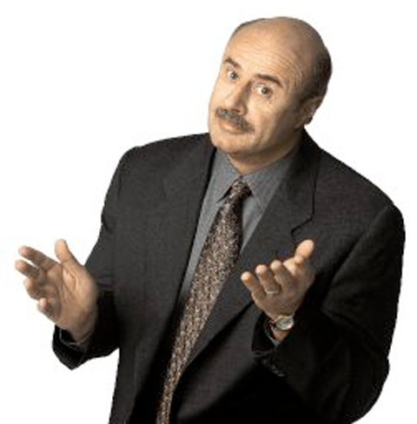
Notes:
Let’s talk about our relationship

Slide 4
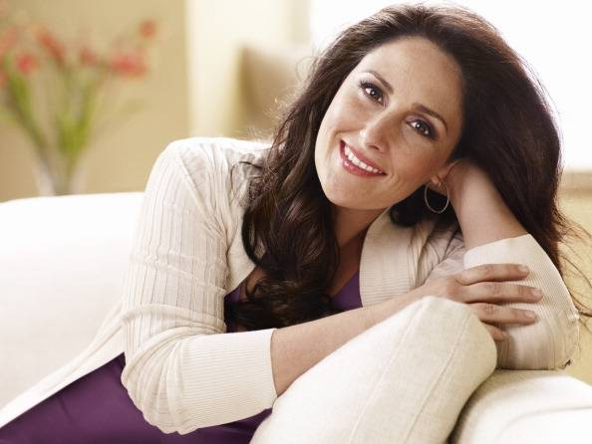
Notes:
That’s better.
I am not a complex organization (although my body is a marvelous machine) and I’m not transmitting public messages. This is about you and me. Your behavior matters – I notice it and it influences me, the way a prerecorded mass media blast CAN’T be impacted. So let’s go on this intellectual journey together.
Also, you’re not bowling alone. You’re sitting in a supersweet, super sweet community and I’m going to have you talking to your neighbor and thinking and talking things out together. Watching this movie is NOT the same as coming to class. I’m trying to give you a value add for messing up your lunch time. You’ve gotta bring it.

Slide 5
Enriching our Minds
Or
Melting Our Brains?
(And if it’s brain melt, how much have I lost, Doc?)
COMM 203: Communication & Mass Media
September 17, 2012
Laurel J. Felt
PhD Candidate, USC Annenberg
www.laurelfelt.org
felt@usc.edu

Slide 6
Why do we engage with media?
So what?
Something’s happening
Let’s measure
Nothing’s happening
What could happen?
Let’s get real

Slide 7
Why do we engage with media?

Slide 8
NO IDEA
“Bryant and Zillmann (1984) presented some evidence concerning the degree to which people, on their own, can report on the processes that govern viewing decisions. Only 14% of their subjects (college undergraduates) ‘were able to articulate a notion which might be considered an informal, personal theory’ (p. 19)” (Webster & Wakshlag, 1985, p. 52).

Slide 9
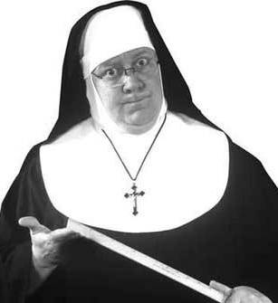
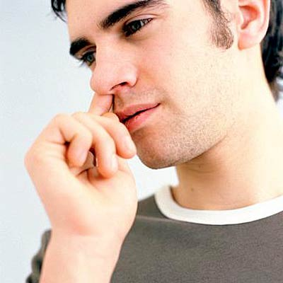
Notes:
Habit

Slide 10
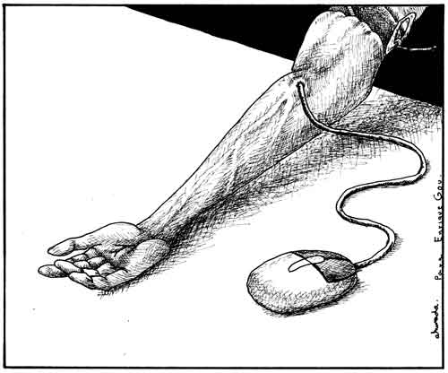
Notes:
Addiction

Slide 11
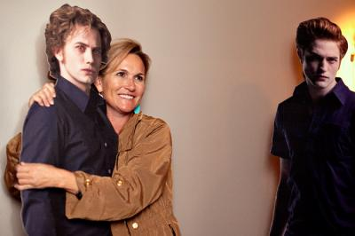
Notes:
Companionship --- parasocial relationships
Jonathan Cohen’s examination of recovery from “breakups” with TV characters correlate with attachment style –
break-up distress was linked to attachment style, the intensity of the paraoscial relationship mediated the effect.
Cohen, Jonathan (2004). “Parasocial Break-up from Favorite Television Characters: The Role of Attachment Styles and Relationship Intensity.” Journal of Social and Personal Relationships, 21 (2), 187-202.

Slide 12
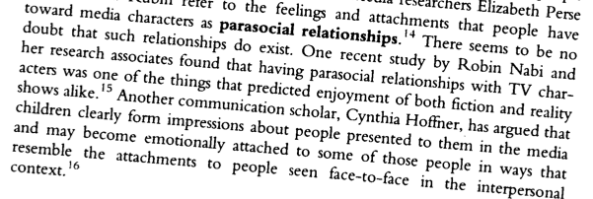
Notes:
ROBIN NABI IN DA HOUSE:
Next Monday, 12pm, Geoff Cowan Forum (ASC 225)
CINDY HOFFNER = friend of Stacy’s ☺

Slide 13
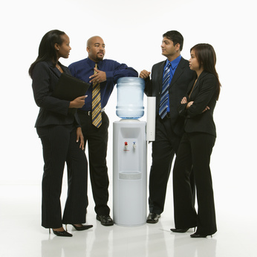
Notes:
Social interaction
Viewing parties
Watercooler chat
Tweeting to satisfy need for camaraderie (Chen, 2011)

Slide 14
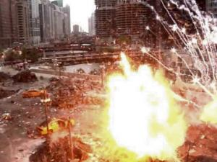
Notes:
Arousal

Slide 15
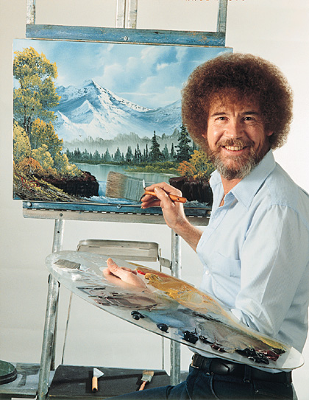
Notes:
Relaxation

Slide 16
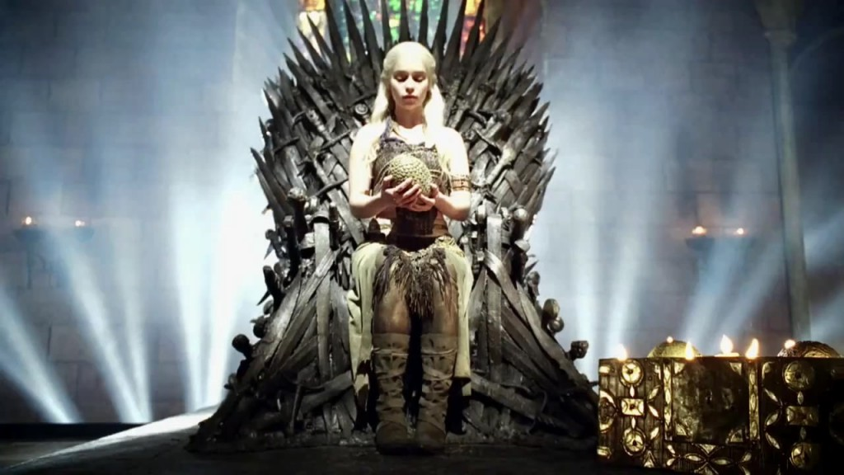
Notes:
Escape

Slide 17
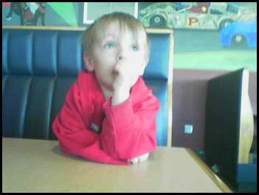
Notes:
Passing time

Slide 18
Your Ideas!
Notes:
Turn to a neighbor and discuss other reasons that this might have left out
Ambiguity (Media Systems Dependency, Ball-Rokeach & DeFleur)
Need for information
WE LOVE STORIES

Slide 19
So what?
Notes:
Why do we care?
-if there’s some way of predicting what compels people to watch TV in general/ certain types of TV/media use, then what? How would that be helpful?

Slide 20
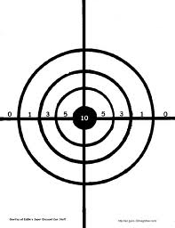

Notes:
-sites of intervention for non-profits or governments, i.e., X and Y are a problem
-capacity to shape products to better fit people’s needs (which can be attractive for folks who want to make a buck)

Slide 21
“The relationship between what viewers bring with them to the viewing experience and how viewing subsequently affects them is one of the most important areas of current research in the uses and gratifications tradition”
(Sparks, 2012, p. 78).

Slide 22
“This study cannot establish whether there is a cause and effect relationship between media use and grades, or between media use and personal contentment.
And if there are such relationships, they could well run in both directions simultaneously”
(Rideout, Foehr & Roberts, 2010, p. 4).

Slide 23
“The entire study of mass communication is based on the premise that there are effects from the media, yet it seems to be the issue on which there is least certainty and least agreement”
(McQuail, 2005, p. 456).

Slide 24

Notes:
“No experiment can ever prove media violence effects behavior, but rather only weaken our belief that there are no consequences from persistent exposure to media violence” (Kline, 2003, p. 11).
CRANKY FOR EFFECTS; peril

Slide 25
Let’s measure
Unobtrusive
Behavior as it occurs
No particular effort
Notes:
“The ideal measurement, then, would be on that is completely unobtrusive, records behavior as it occurs, and requires no particular effort on the part of the respondent” (Webster & Wakshlag, 1985, p. 55).

Slide 26
WHAT | HOW | PRO’S | CON’S
What you’re paying attention to in the moment
Notes:
What you’re paying attention to in the moment
Distractor or eye-tracker
Sesame Street story
See what holds your interest in the room/on-screen
Superficial viewing conditions

Slide 27
WHAT | HOW | PRO’S | CON’S
What’s playing on the TV
Notes:
Nielsen meters
The Ratings Game (1984)
http://www.imdb.com/ title/tt0087979/
More reliable than self-report
Varies/person, don’t know how many people are in the room or what they’re doing
Metering
http://www.youtube.com/watch?v=jYrVijea0UM&feature=related
Sample Recruitment
http://www.youtube.com/watch?v=GnMdmX6C5Oc&feature=relmfu
Sampling
http://www.youtube.com/watch?v=t0ky0zhcDww&feature=relmfu
Ads online
http://www.youtube.com/watch?v=s4DBrRKZk0o&feature=related

Slide 28
WHAT | HOW | PRO’S | CON’S
What you’re paying attention to in the moment + What’s playing on the TV
Notes:
In-home cameras
Nickelodeon Kids & Family Research; discuss reality TV
Capture what’s happening in an organic setting, can track eye movement + collect other data (i.e., folding the laundry, arguing over show, program-related discussion)
Is this really organic? – acting for the camera (aka, social desirability response), the Hawthorne effect + self-selection bias; onerous to code; creepy & tough to sell; expensive to set up and analyze
Researcher present, either at home or in lab
explain “Hawthorne effect”
Capture what’s happening in an organic setting, know who’s in the room, who chose the show, how much attention is paid + other data
Is this really organic? – acting for the camera, the Hawthorne effect the Hawthorne effect + self-selection bias

Slide 29
WHAT | HOW | PRO’S | CON’S
What you’re paying attention to in the moment + What’s playing on the TV
Notes:
In-home cameras
Nickelodeon Kids & Family Research; discuss reality TV
Capture what’s happening in an organic setting, can track eye movement + collect other data (i.e., folding the laundry, arguing over show, program-related discussion)
Is this really organic? – acting for the camera (aka, social desirability response), the Hawthorne effect + self-selection bias; onerous to code; creepy & tough to sell; expensive to set up and analyze

Slide 30
WHAT | HOW | PRO’S | CON’S
What you’re watching NOW
Notes:
Scanners
Big Brother, The Net
Unobtrusive, no effort
Ethical issues, context-blind

Slide 31
WHAT | HOW | PRO’S | CON’S
What you say you’re watching NOW
Notes:
Telephone coincidental, SMS
Piloted in developing countries for health care, ICT4D
No recall error, quick
Annoying, expensive, privacy?

Slide 32
WHAT | HOW | PRO’S | CON’S
What you say you watch as you’re watching or a little after you’ve watched it
Notes:
Diaries; Data from the media use diaries were used primarily for quantifying the amount of media multitasking.
KFF 2010 diary
Rich data, can include more fields than just TV
Self-selection bias; inaccuracy; social desirability; literacy assumption (excluding young children, illiterates, specially abled)

Slide 33
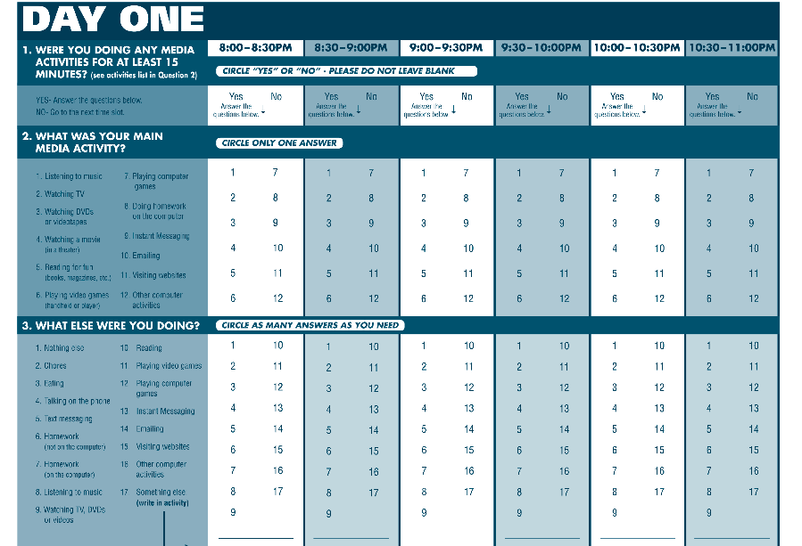

Slide 34
WHAT | HOW | PRO’S | CON’S
What you say you watch much after you’ve watched it
Notes:
Surveys; Survey respondents completed anonymous, 40-minute, self-administered written questionnaires in the classroom. Trained interviewers were present in each classroom to provide assistance if needed.
My issue when we hired Magid; Final Q on KFF
Rich data, can include more fields than just TV
Self-selection bias; recruitment challenges (diminished random digit dial, low rates of online participation) inaccuracy; social desirability; memory error; error by misunderstanding the Q

Slide 35
KFF, 2010, p. 65
Self Report

Slide 36
KFF, 2010, p. 65
Self Report

Slide 37
Big Four Methods
Survey
Diary
Cameras (lab, in home)
Capturing devices
Notes:
Generation M2: Media in the Lives of 8- to 18-year-olds
(Rideout, Foehr & Roberts, 2010)

Slide 38
7 hours 38 minutes/day
10 hours 45 minutes/day
Notes:
-average of 7:38/day, 7 days a week (increase from 2004, 6:21/day); 10:45 exposure due to multitasking
-“… constant stream of messages about families, peers, relationships, gender roles, sex, violence, food, values, clothes, and an abundance of other topics too long to list”
-“… which activities they engage in, how often they multitask, and how they di_er from one another in the patterns of their media use. Our aim is to provide a more solid base from which to examine media’s effects on children and to help guide those who are proactively using media to inform and educate America’s youth.

Slide 39
Prevalence of TV
still ubiquitous!
96.7% of American households own a set
(down from 98.9%)
lowest in 20 yrs
(sourse: NY Times, 5/3/2011)

Slide 40
Nielsen Company
Household TV Use
2009 8 hrs., 21 mins.
2008 8 hrs., 21 mins.
2007 8 hrs., 14 mins.
1999 7 hrs., 26 mins.
1990 6 hrs., 53 mins.
1970 5 hrs., 56 mins.
Source: The Nielsen Company, NTI Annual Averages, 1994-present estimates based on start of broadcast
season September to September. Beginning in 2007, estimates include Live+7 HUT viewing.
Prior to 9/87: Audimeter Sample; 9/87 to present: People Meter Sample. This information was featured
in TV_Basics.pdf

Slide 41
Nielsen Company

Slide 42
Prevalence of Media Use
Kaiser Family Foundation (2010)

Slide 43
Kaiser Family Foundation (2010)

Slide 44
Nothing’s happening
Notes:
Cranky: possibility

Slide 45
“While tests of statistical significance are a vital tool of the social sciences, they seem to have been more often used in this field as instruments of torture on the data until it confesses something which could justify publication in a scientific journal. If one conclusion is possible, it is that the jury is not still out. It's never been in. Media violence has been subjected to lynch mob mentality with almost any evidence used to prove guilt”
(emphasis added; Cumberbatch, 2001, cited in Heins & Bertin, 2002, p. 2).
Notes:
Cranky: possibility

Slide 46
What could happen?
Notes:
Cranky: possibility

Slide 47
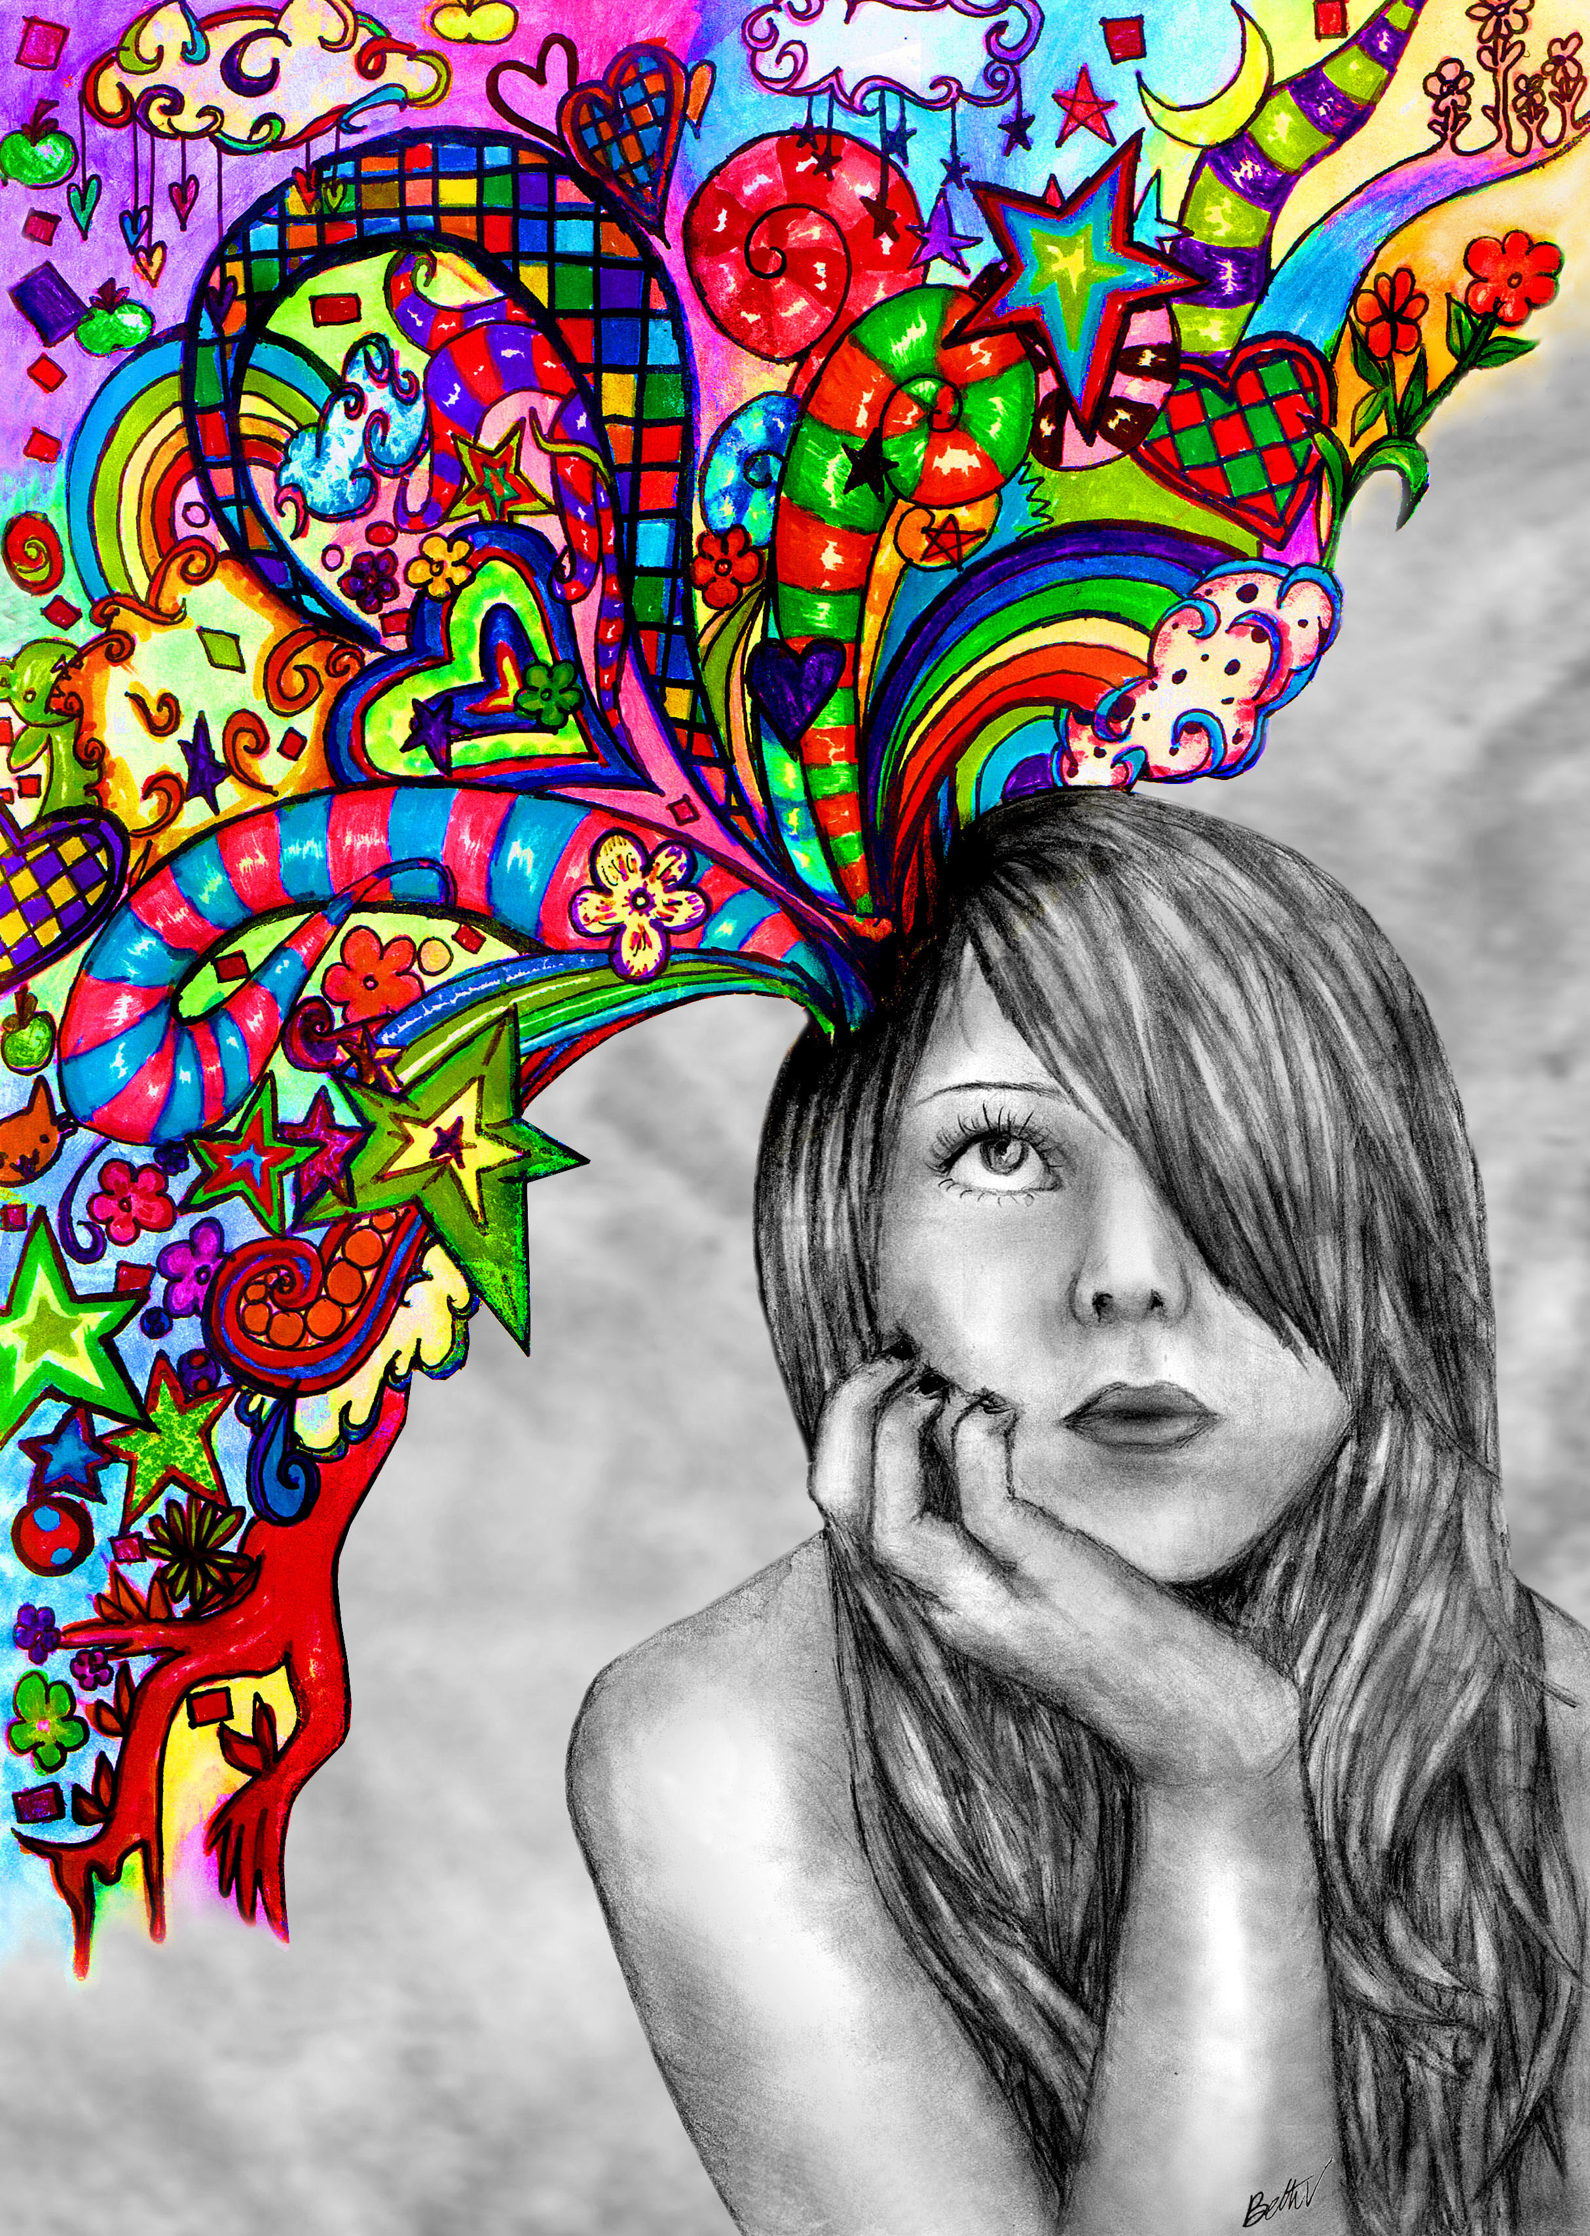
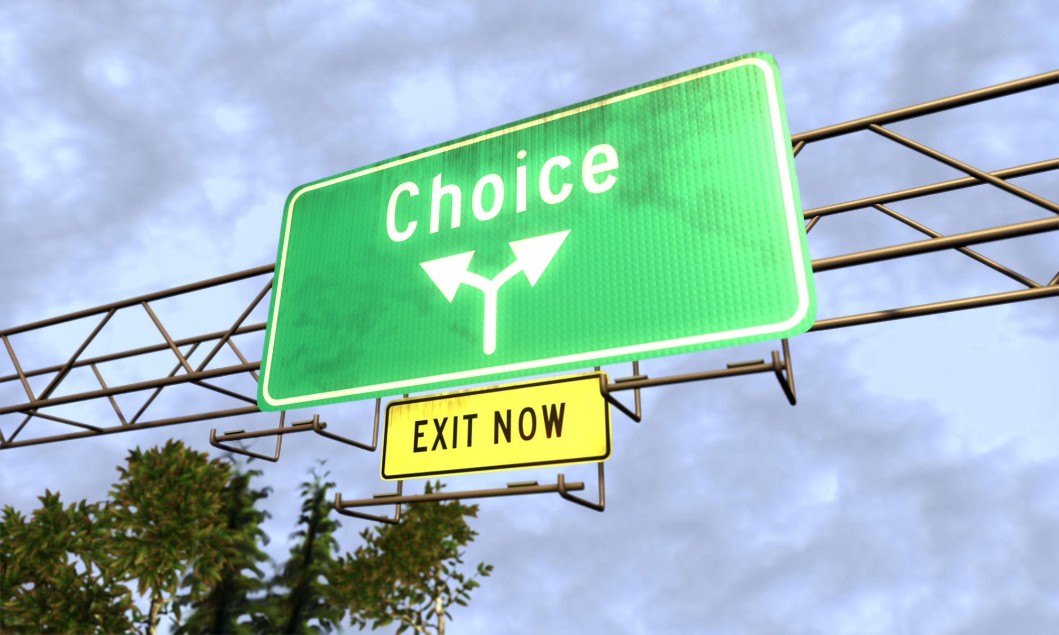
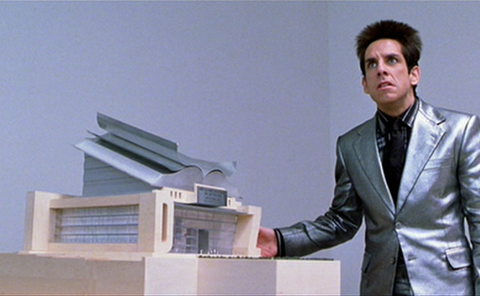
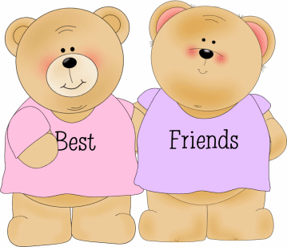
Notes:
Close social ties?
-sensation of these ties via parasocial interaction
-means of better engaging with people due to ability to observe appropriate social behavior and fodder for conversation
-ways of finding people, e.g., fan communities, online niches (Jamaica found her boyfriend via WoW)
Fantasy play and/or abilities to problem-solve?
-Diane Levin’s publications
-Gotz, Lemish, Moon, & Aidman. (2005). When Harry Potter Meets Pokemon in Disney Land: Media and the Make-Believe Worlds of Children.
Reading?

Slide 48
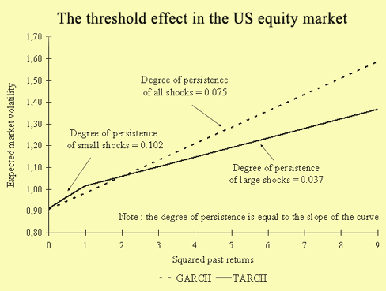
Notes:
Threshold effect:
-no negative impacts until meet/surpass ten hour/day mark;
-Lapierre, Piotrowski & Linebarger (2012) found negative impacts on 8 months to -8 years-old children’s cognitive and reading tasks when the TV is “always on” – 4 hours/day of background (program content irrelevant) http://www.asc.upenn.edu/News/PressDetail.aspx?id=106

Slide 49
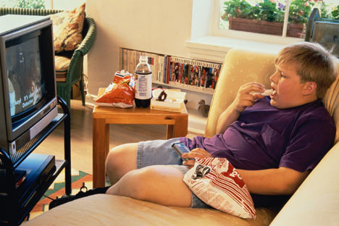
Notes:
Obesity
-not moving as you watch
-snacking as you watch
-watching commercials that increase your likelihood of purchasing unhealthy foods
-discouragement about body as look upon the thin actors and eat to console oneself?

Slide 50
Let’s get real
Notes:
Livingstone, S. (2007). Do the media harm children? Reflections on new approaches to an old problem. Journal of Children and Media, 1(1), 5-14.
“The polarization of approaches that bifurcates our research community undermines our collective ability to speak powerfully to our source fields—of media studies, of childhood studies” (Livingstone, 2007, p. 5).

Slide 51

At present, we can surely agree that, to those who fear that the media are responsible for a growing range of social problems, one might argue that the evidence base is carefully and critically scrutinized, for such findings as exist generally point to more modest, qualified and context-dependent conclusions.
To those who hope, however, that the media play little or no role in today’s social problems, one might point to the complex and diverse ways in which different media are variably but crucially embedded in most or all aspects of our everyday lives, and that it seems implausible to suggest that they have no influence, whether positive or negative.
The truth, surely, as always, lies somewhere in the middle... Just how we should conceptualise, debate, and research this is the challenge ahead. (Livingstone, 2007, p. 12).
Notes:
London School of Economics

Slide 52
“In short, it seems wise to frame the question differently, eschewing the bald question – do the media have harmful effects or not, and instead insisting on a more complex formulation of the question, namely—in what way and to what extent do the media contribute, if at all, as one among several identifiable factors that, in combination, account for the social phenomenon under consideration (violence, racism, etc.)” (p. 9).
“Just how we should conceptualise, debate, and research this is the challenge ahead” (p. 12).
Notes:
London School of Economics

Slide 53
THANK YOU!

Slide 54
Factors Affecting Media Use
age (8- to 18-year-olds)
age (0 to 8-year-olds)
age (55+ year-olds)

Slide 55
Commonsense Media, Fall 2012
asdfadsf
1,384 parents of 0- to 8-year olds were
surveyed May-June 2011. Probability based online panel, assumed to be representative of the U.S. population.
Margin of error +/- 2.6% and the response rate was 59%. (see page 15 of the report).

Slide 56
Media Use (0-8 year olds)
Commonsense
Media
(Fall 2011)

Slide 57
Senior citizens =
“Embracers” of television:
13% of population
1.9-3.3% of TV pt characters
4.3% of Film characters (2008)
(Davis, 1971; Gerbner & Ozyegin, 1997; Vernon et al. 1990; Smith & Choueiti, 2011;
US Census, 2011)

Slide 59
Factors Affecting Media Use
age
gender

Slide 60
8- to 18-yr olds
Source:Kaiser Family Foundation, 2010

Slide 61
8- to 18-yr olds
Source:Kaiser Family Foundation, 2010

Slide 62
Ratio Males to Females:
2.57 to 1 G-rated Films (Smith et al., 2006)
2.71 to 1 G, PG, PG-13, R-rated films (Smith et al., 2008)
1.92 to 1 G, PG, PG-13, R-rated Jacket Covers (Smith et al.2008)
2.66 to 1 Oscar Nominated Best Picture (Smith et al., 2008)
1.67 to 1 Children’s Television Programming (Smith et al., 2007)
5.98 to 1 Top-Selling Video Games (Downs & Smith, in press)
1.92 to 1 Prosocial Acts on American TV (Smith et al., 2006)
3 to 1 Violent Acts on American TV (Smith et al., 1998)
Form of Content?

Slide 63
Factors Affecting Media Use
age
gender
race/ethnicity

Slide 64
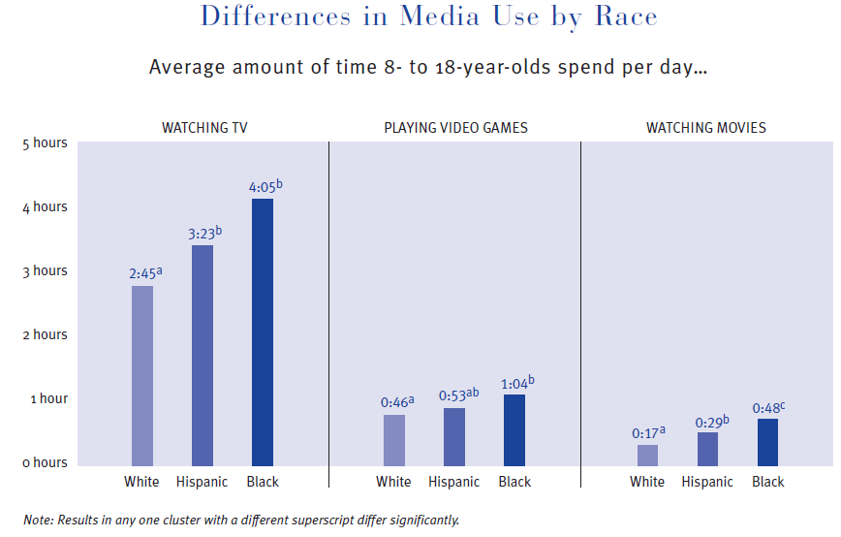
Kaiser Family Foundation, 2010

Slide 65
Race/Ethnicity – Commonsense Media
Note: Commonsense Media, page 25. Ward, L.M (2004), marshalling evidence from other studies argues that “Black children have been reported to hold a more positive orientation toward the media than Whites (Comstock & Cobby, 1979; Graves, 1996; Stroman, 1991). Evidence indicates that African Americans compared with White Americans, hold more favorable attitudes towards TV (Bales, 1986), report higher levels of satisfaction with TV (Albarran & Umphrey, 1993) and are more likely to report using TV for information and as a source of guidance (e.g.Greenberg, 1972).” Developmental Psychology, 40 (2), p. 285.

Slide 66
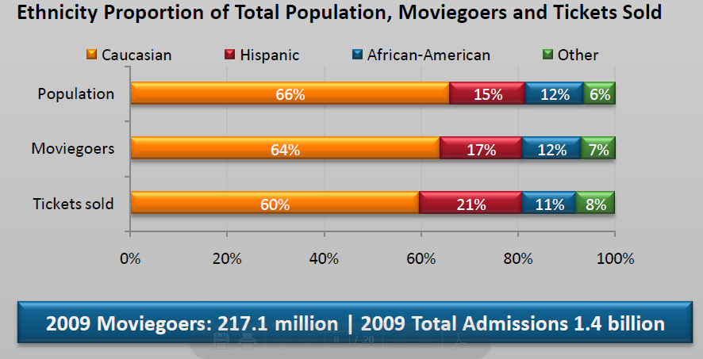

Slide 67
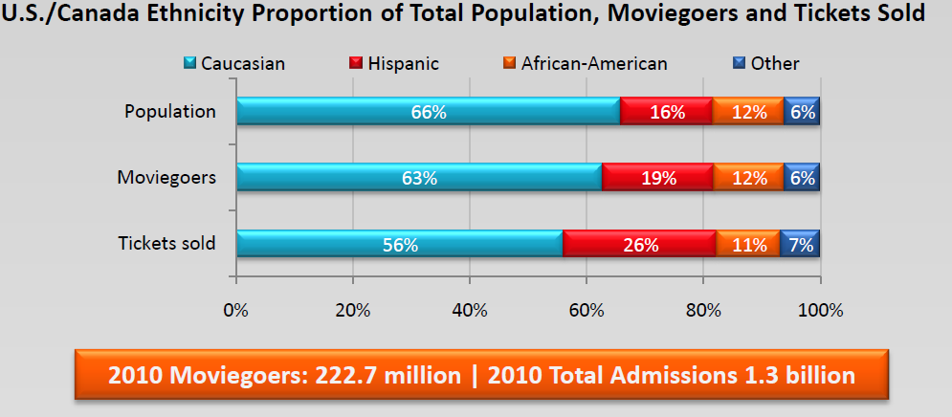

Slide 68
Factors Affecting Media Use
age
gender
race/ethnicity
socio economic income

Slide 69
Commonsense
Media (2011)
Viewing by
Parent Income,
0- to 8-year olds

Slide 70
Reaction Paper #2 – Media Exposure
Half a page; 10 points
-Select a medium: Television, The Internet, or Radio
-Conceptualize exposure to it (what would exposure to _____ look like?).
-Operationalize exposure to it, meaning come up with a way of measuring exposure to the medium (i.e., quantify exposure). What sort of technology, tools, device, etc. would you use and how?
Don’t forget your Name & Student ID#!

